Slide 1
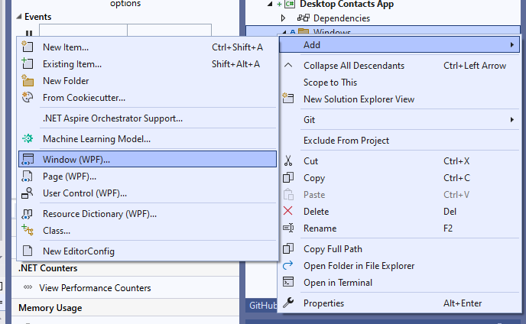
Add new Window (WPF) into a folder: Windows

Slide 2
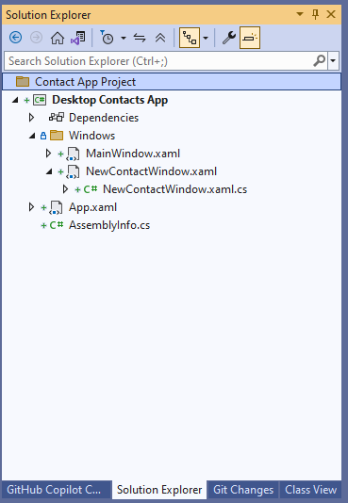

Slide 3
NewContactWindow.xaml
<Grid>
<StackPanel Margin="10">
<TextBox x:Name="nameTextBox"
Margin="0,0,0,5"/>
<TextBox x:Name="emailTextBox"
Margin="0,0,0,5"/>
<TextBox x:Name="phoneTextBox"
Margin="0,0,0,5"/>
<Button Content="Save"
Click="Button_Click"/>
</StackPanel>
</Grid>
Create three textboxes for name, email and phone.
Then add a button to save the contact into the dB.

